Slide 5
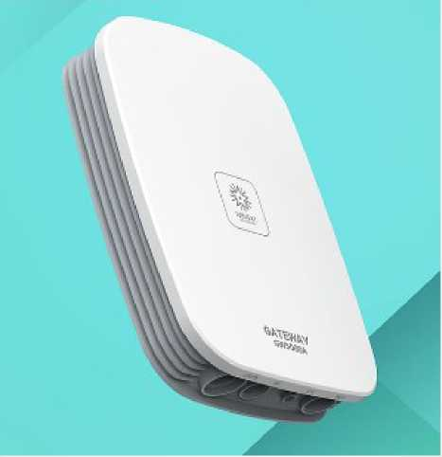
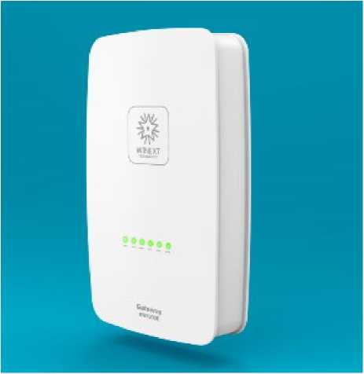
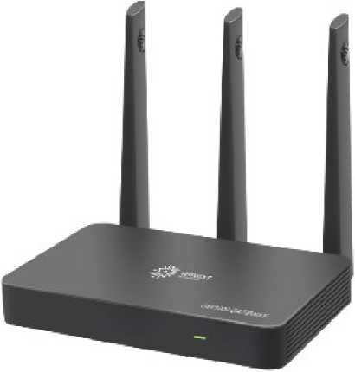
LoRa gateways
GW5000A is an industrial-grade outdoor gateway with IP67 and CE/FCC certified.
GW5000E is a light-weighted macro gateway with IP65
GW1000 is a indoor gateway for smart building
LoRa

Slide 6
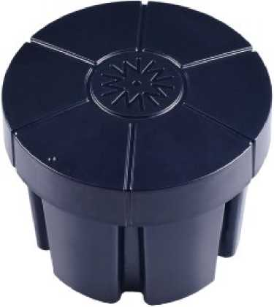
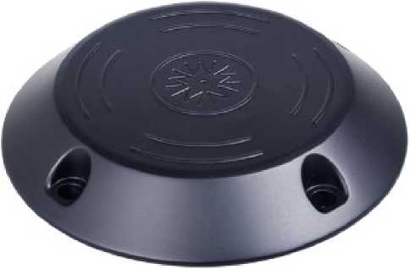
LoRa end devices-■■-smart parking
AN-101C in-ground type geomagnetic parking sensor with IP68
AN-101D surface-mounted type geomagnetic parking sensor with IP68
LoRa

Slide 7
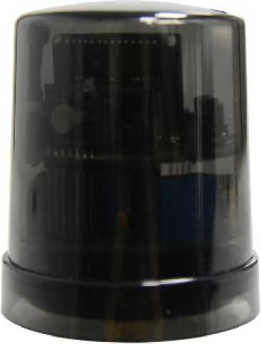
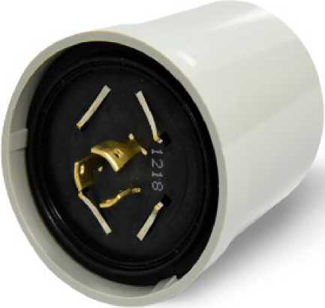
LoRa end devices-■■-smart street lighting
WLC-NEMA-01 lamp controller with
NEMA standard
WLC-NEMA-02 lamp controller with
NEMA standard and photocell
LoRa

Slide 8
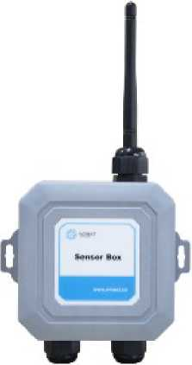
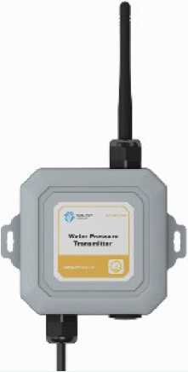
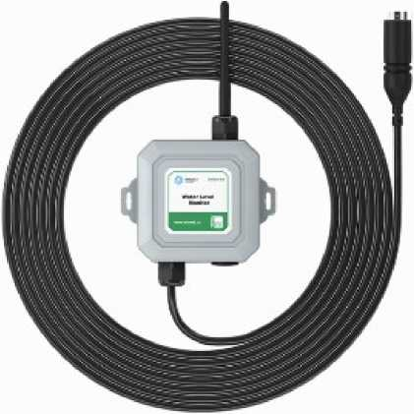
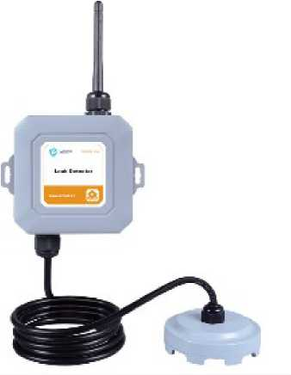
LoRa end devices-■■-smart industry
AN-201 multiiunctional
SensorBox
AN-202A Water pressure transmitter
AN-203A Water level monitor
AN-204A Water leakage detector
LoRa

Slide 9
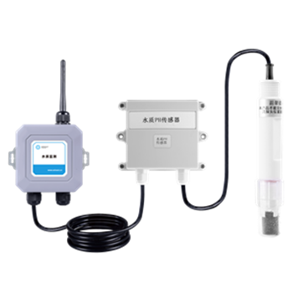
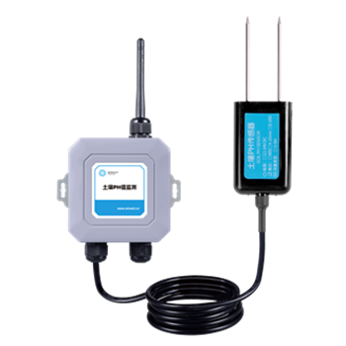
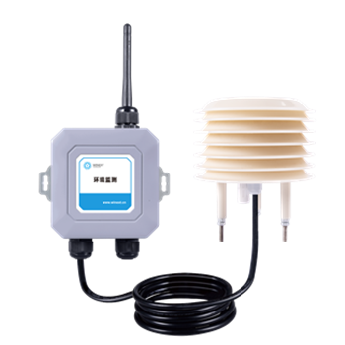
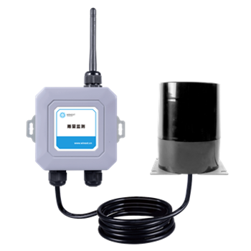
LoRa end devices-■■-smart farm
AN-206 Water PH Value Mointor
AN-207 Soil PH value Monitor
AN-208 meteorological
monitoring unit
AN-209 rainfall value monitor
LoRa

Slide 10
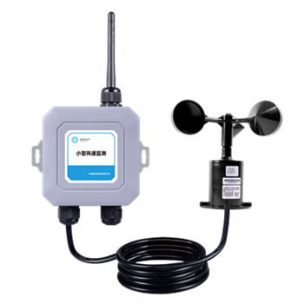
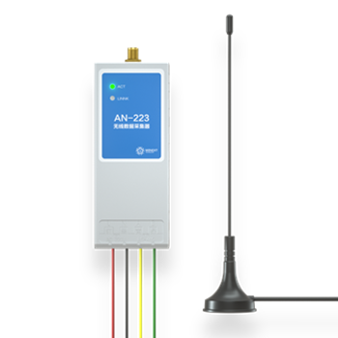
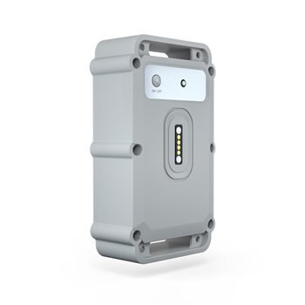
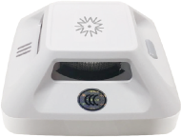
LoRa end devices-■■-smart industry
AN-210 Wind speed Monitor
AN-233 Wireless Data acquisition unit
AN-113 Location Monitor
AN-102B Smoke Alarm
LoRa

Slide 11
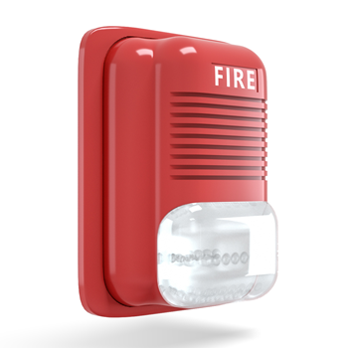
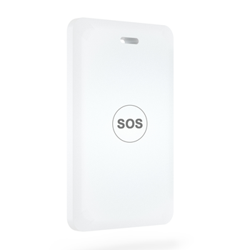
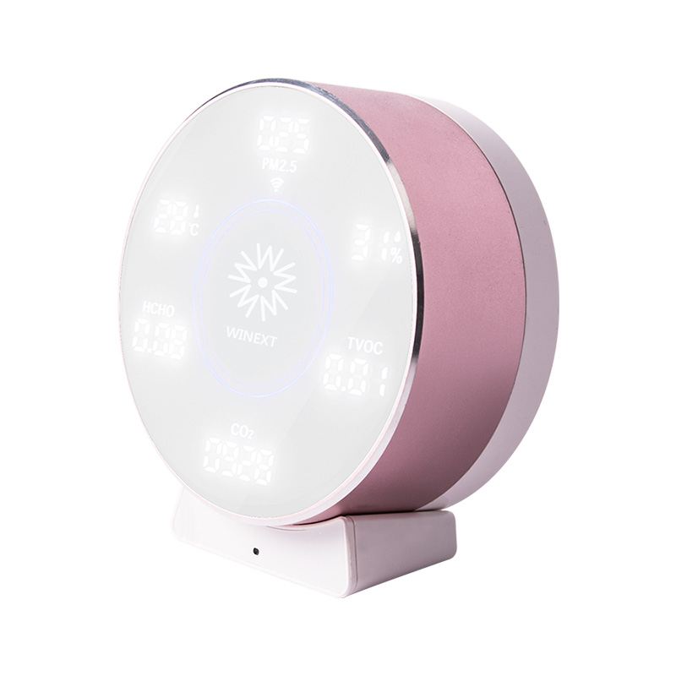
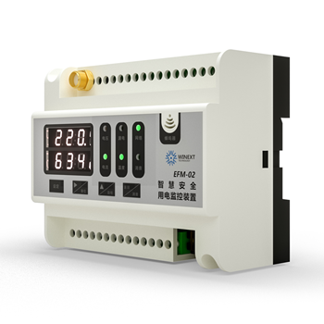
LoRa end devices-■■-smart safety
AN-307 Fire Alarm
CM100 Personal Location Monitor
CU300 Personal Location Monitor
EFM02 Electrical Fire Monitor
LoRa

Slide 12
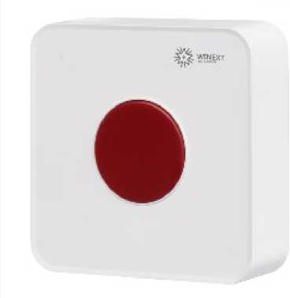
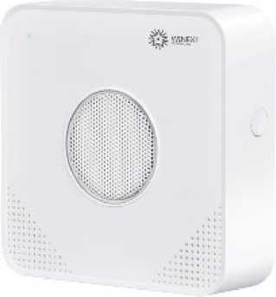
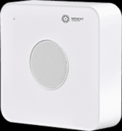
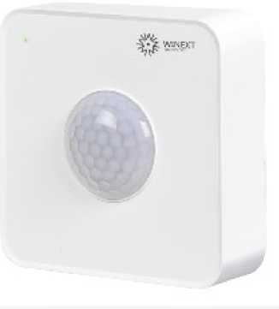
LoRa end devices-■■-smart building
AN-301 SOS button
AN-302 gas monitor
AN-303 temperature humidity sensor
AN-304 PIR motion detector
LoRa

Slide 13
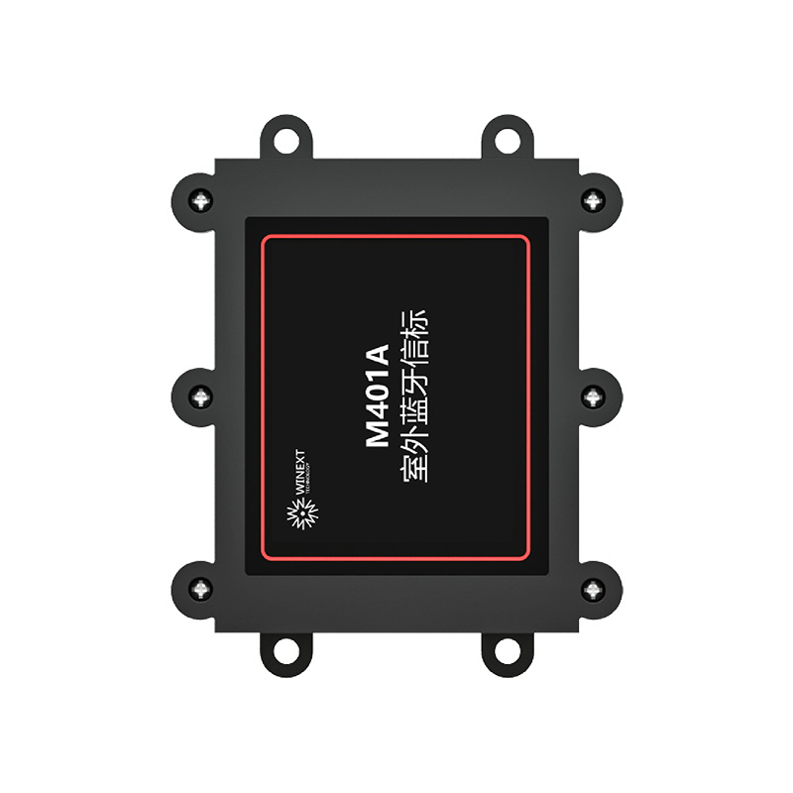
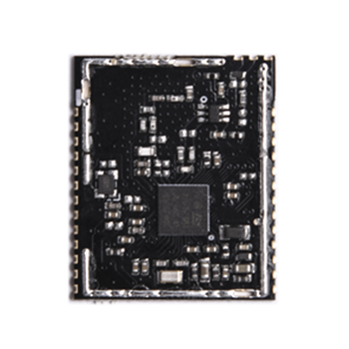
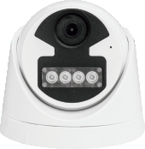
LoRa end devices-■■
M401A Buletooth Beacon
M300C1 LoRa Module
V200 AI High Denifition Camera
LoRa

Slide 14
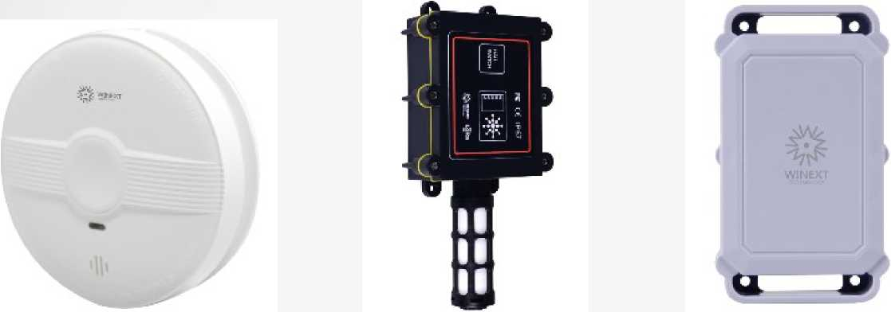
LoRa end devices
AN-102C smoke detector
AN-103 temperature humidity sensor
AN-122-A02 LoRa GPS tracker
AN-106 LoRa tester
LoRa

